Slide 1
Project Presentation of Industry Oriented Hands on Experience (22CS422)
On
EARLY DIAGNOSIS OF ALZHEIMER’S DISEASE USING MACHINE LEARNING
Karanpreet Singh (2210990482)
Karishma Dhawan (2210990483)
Kanishk Kharbanda (2210990472)
Jasmine Rathor (2210990450)
Supervised By
Dr. Gifty Gupta
Department of Computer Science and Engineering,
Chitkara University, Punjab

Slide 2
Introduction
Alzheimer’s disease affects memory and thinking ability.
Early diagnosis helps slow disease progression.
Traditional diagnosis methods are expensive and time-consuming.
Machine learning can improve early detection accuracy.
Proposed system provides real-time prediction.
2

Slide 3
Problem Statement
Delayed diagnosis in traditional systems.
High cost of MRI and PET scans.
Lack of real-time prediction systems.
Limited user-friendly healthcare interfaces.
Need for affordable and accurate diagnostic support.

Slide 4
Objectives
Develop a machine learning-based prediction system.
Provide real-time Alzheimer diagnosis.
Create an easy-to-use web interface.
Improve prediction accuracy using ML algorithms.
Assist healthcare professionals in decision-making.

Slide 5
System Architecture
Frontend
React.js
Backend
FastAPI
Machine Learning
Random Forest
SVM
CNN
Dataset
ADNI
OASIS

Slide 6
Dataset and Preprocessing
Datasets Used
ADNI Dataset
OASIS Dataset
Preprocessing Steps
Missing value handling
Data cleaning
Feature scaling
Normalization

Slide 7
Results and Analysis
Real-time prediction achieved.
Fast response generation.
High prediction accuracy.
User-friendly interface.
Reliable confidence score output.

Slide 8
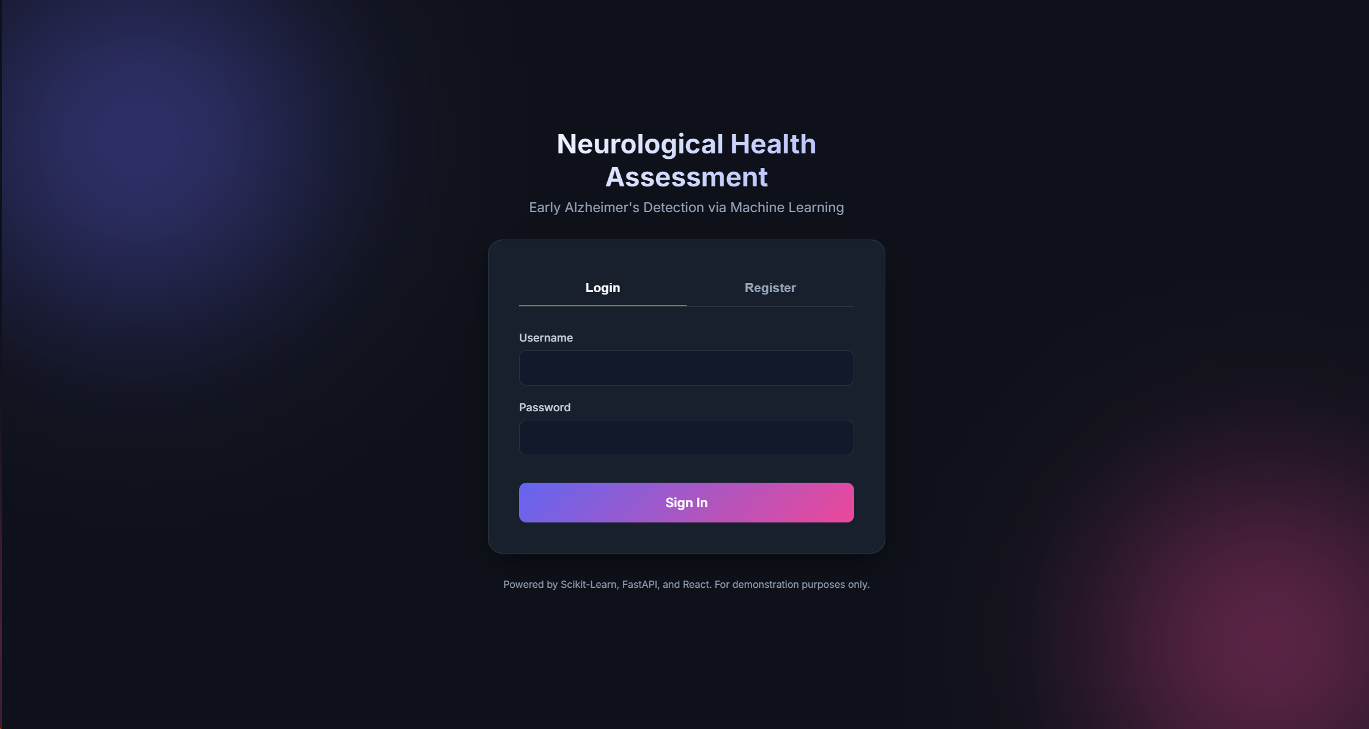
Snapshots
Login Module : This module allows registered users to securely access the Alzheimer’s assessment system using their username and password. It ensures authorized access to patient data and prediction features.

Slide 9
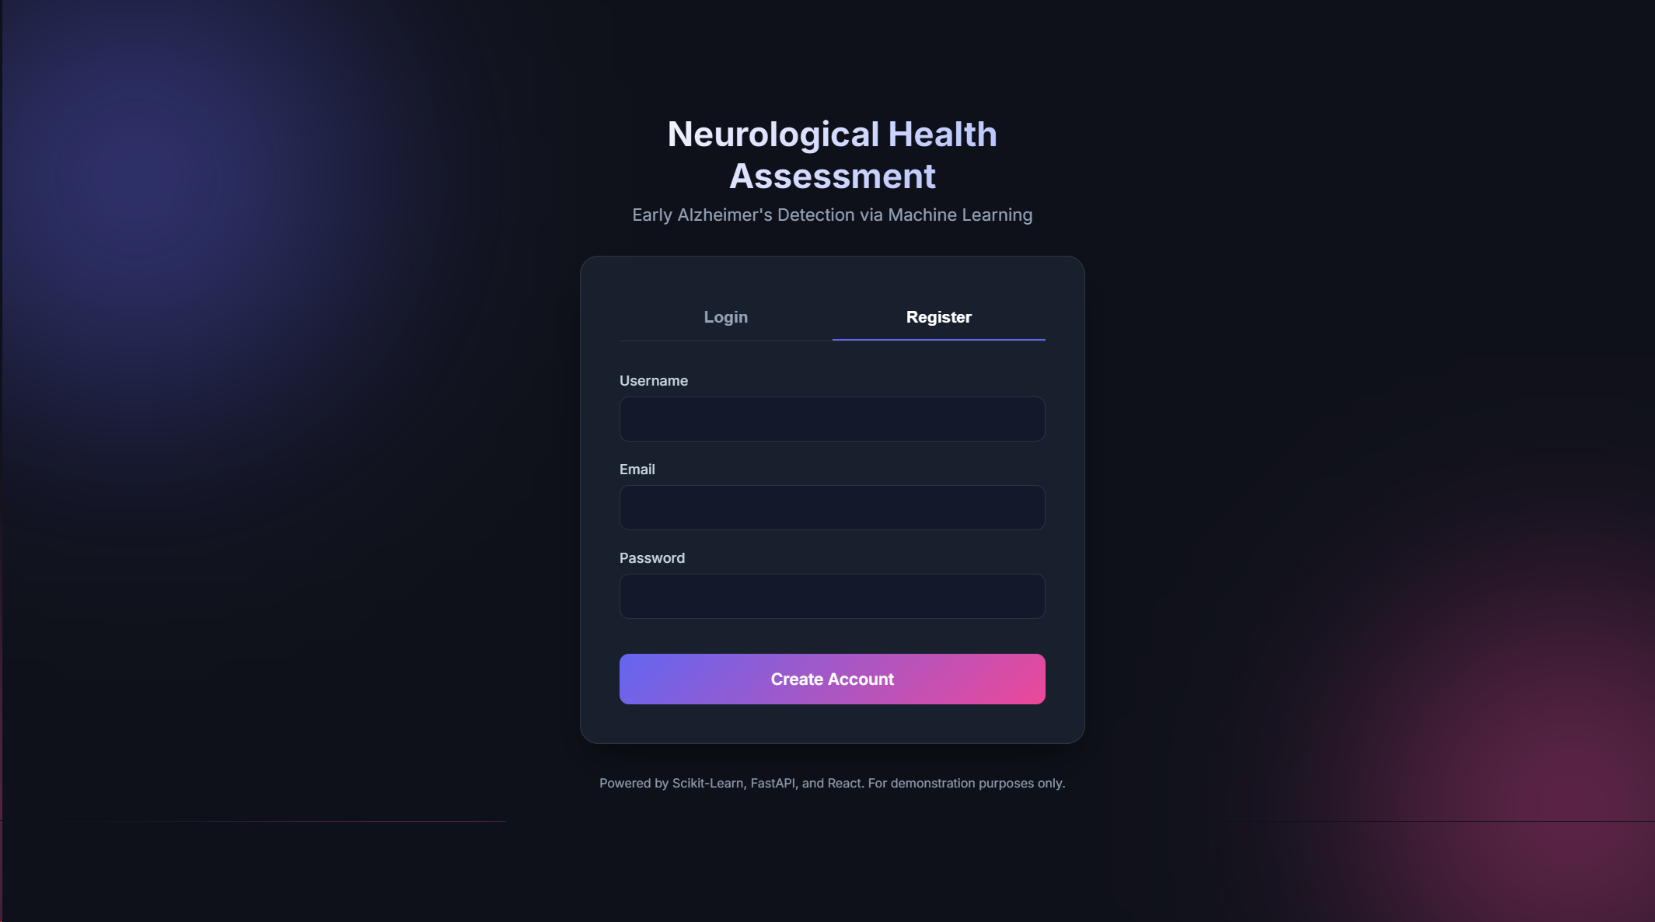
Snapshots
Registration Module : This module enables new users to create an account by entering basic details such as username, email, and password. It helps maintain secure and personalized access to the system.

Slide 10
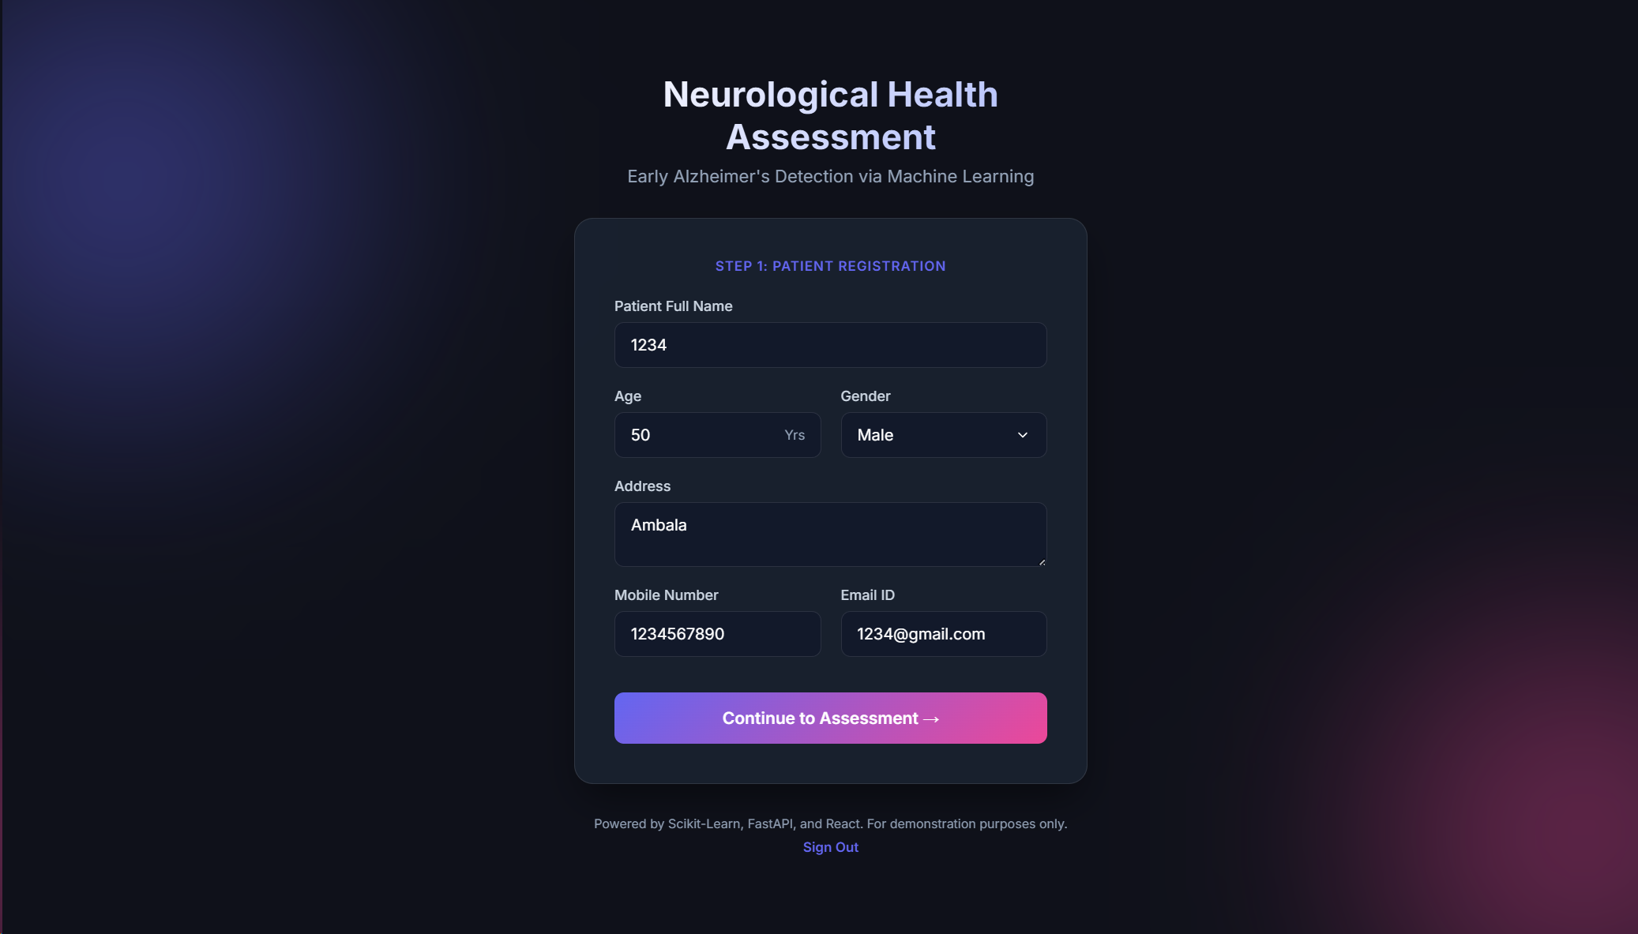
Snapshots
Patient Registration Module : This module collects patient details such as name, age, gender, address, contact number, and email ID. It provides a simple and secure interface for registering patients before starting the Alzheimer’s assessment process.

Slide 11
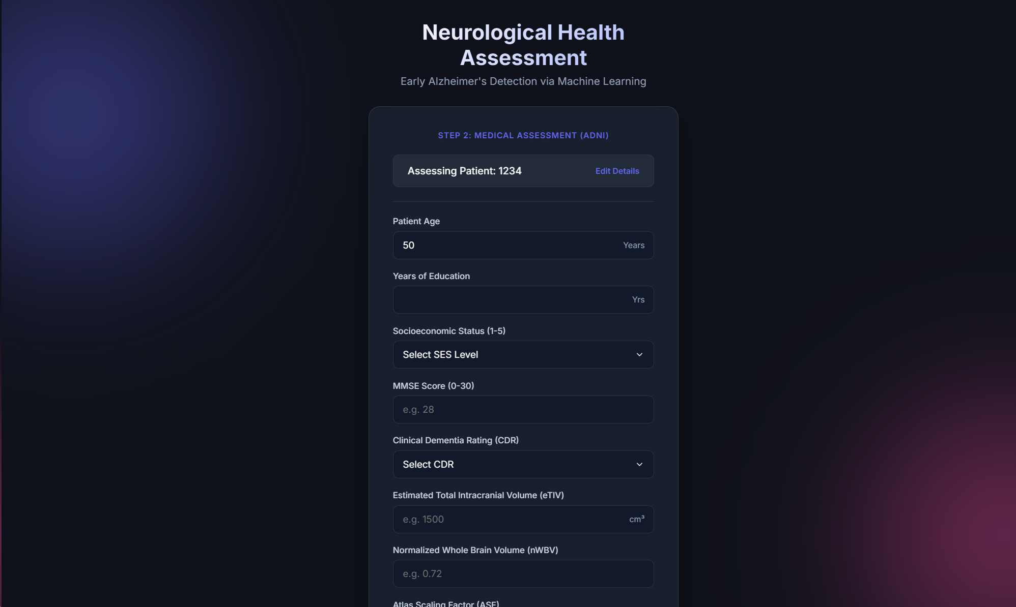
Snapshots
Medical Assessment Module : This module allows users to enter clinical and cognitive information such as MMSE score, CDR value, and brain volume measurements. The collected data is used by the machine learning model to analyse the patient’s neurological health condition.

Slide 12
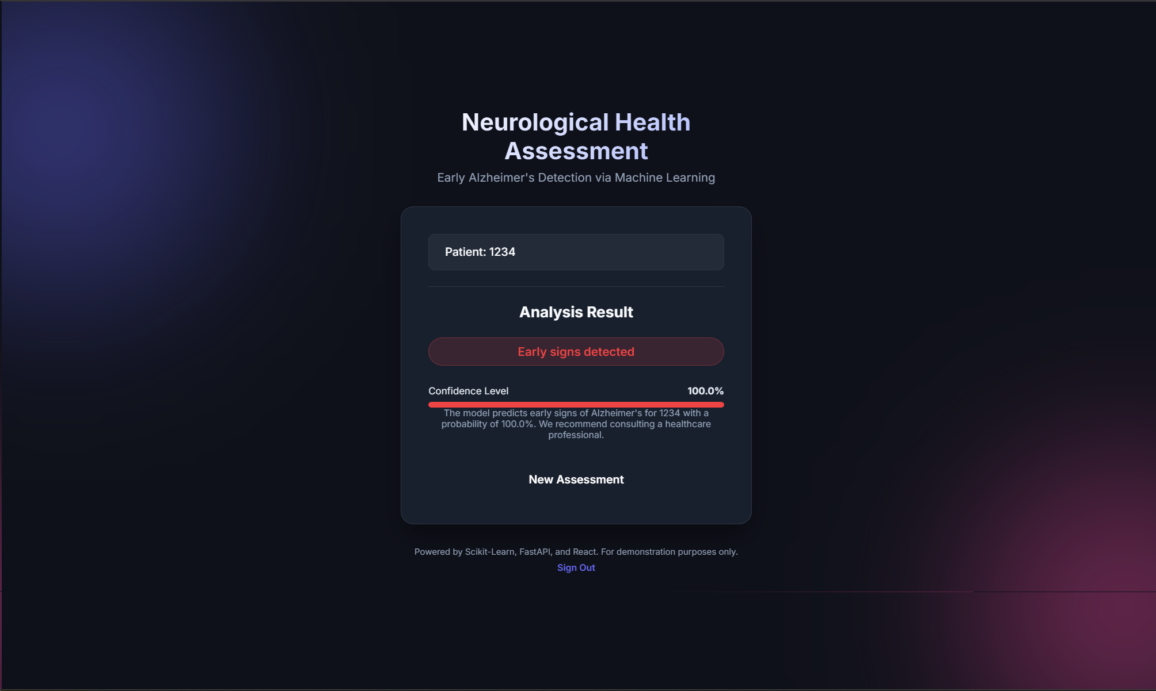
Snapshots
Result Prediction Module : This module displays the prediction result generated by the machine learning model. It shows whether early signs of Alzheimer’s disease are detected along with the confidence score for better understanding and decision-making.

Slide 13
Advantages
Faster diagnosis
Affordable solution
Real-time prediction
Easy accessibility
Practical healthcare implementation

Slide 14
Future Scope
MRI scan integration
Explainable AI
Mobile application
Cloud deployment
Hospital system integration
Remote healthcare monitoring

Slide 15
Conclusion
Machine learning improves early Alzheimer detection.
Random Forest achieved highest accuracy.
Web-based system provides real-time results.
System supports healthcare professionals.
Practical and scalable healthcare solution.

Slide 16
Thank You
16

